Slide 1
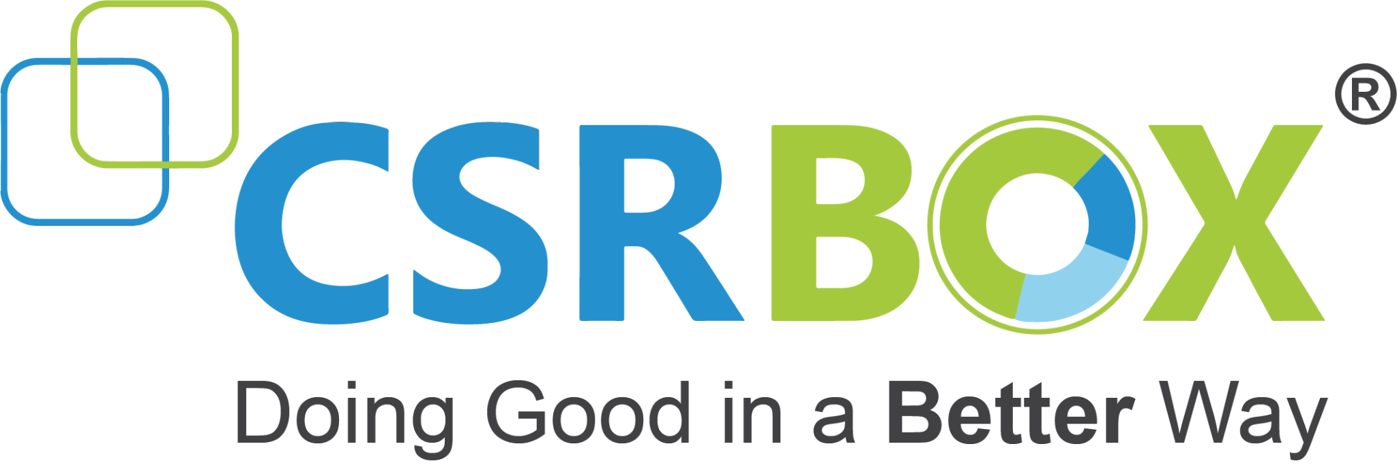
IBM SkillsBuild for Adult Learners - Data Analytics
Data Analytics Internship Program 2024 Final Project Presentation
Project Name : Evaluating Nutritional Density of Foods to Enhance Dietary Health and Well-Being Team Name :GBU@MCAAI2024
College Name : Gautam Buddha University

Slide 2
Team Members
Rashmi Gupta
Shubham Kumar Yadav
Swadha Shukla
Rishabh Chaudhary
Nishita Saini
Prachi Khedia
Kaustubh Raj

Slide 3
Introduction
Overview of the Project
This project evaluates the nutritional density of various foods to promote healthier dietary habits. By analyzing comprehensive nutritional data, it aims to identify foods that offer the best balance of essential nutrients, supporting Sustainable Development Goals (SDG 2: Zero Hunger and SDG 3: Good Health and Well-Being).
Objective
To analyze and compare the nutritional density of different foods, providing actionable insights for healthier eating habits and contributing to improved dietary health and overall well-being.

Slide 4
Problem Identification
Problem Statement
Many individuals struggle with making informed dietary choices due to insufficient knowledge about nutrition and the prevalence of misleading information, leading to poor health outcomes.
Significance of the Problem
Addressing nutritional awareness can reduce deficiencies in essential nutrients and lower the risk of chronic diseases, promoting overall health and well-being.
Relevant SDGs
SDG 2: Zero Hunger - By identifying nutrient-rich foods, the project supports efforts to combat hunger and malnutrition.
SDG 3: Good Health and Well-Being - Promoting healthier dietary choices enhances individual health outcomes and well-being.

Slide 5
Data Collection
Sources of Data
Kaggle "Food Nutrition Dataset"
Food Nutrition Dataset (kaggle.com)
Data Description
Nutritional information on calories, fats, carbohydrates, proteins, vitamins, and minerals for various foods.
Data Collection Methods
Extract data from multiple CSV files.
Clean and preprocess data for consistency and analysis.

Slide 6
Data Preprocessing
Data Cleaning Methods
Combined multiple CSV files into a single dataset.
Dropped unnecessary columns for streamlined analysis.
Handling Missing Values
Replaced missing values with zeros or appropriate placeholders to ensure data integrity.
Data Transformation Techniques
Standardized data formats for consistency.
Aggregated data for comparative analysis of nutritional density.

Slide 7
Data Analysis
Analytical Tools and Methods Used
Python Libraries: Utilized Pandas for data manipulation, Matplotlib for visualization, and IPython widgets for interactive user interfaces.
Google Colab: Provided a cloud-based environment for executing Python code and interactive visualizations.
Key Findings
Identified foods with the highest nutritional density based on a comprehensive analysis of essential nutrients.
Revealed significant differences in nutrient content among various foods.
Insights Derived
Clear recommendations for nutrient-rich foods that support healthier dietary choices.
Enhanced understanding of the nutritional value of different foods, promoting better overall health and well-being.

Slide 8
Hypothesis Development
Formulated Hypothesis
Systematically evaluating and comparing the nutritional density of various foods will identify specific foods that provide significantly higher health benefits.
Rationale Behind the Hypothesis
By understanding the nutrient profiles of different foods, individuals can make more informed dietary choices, leading to improved health outcomes and alignment with SDG goals.
Method for Testing the Hypothesis
Data Collection: Gather comprehensive nutritional data from the Kaggle "Food Nutrition Dataset."
Data Analysis: Use Python libraries for exploratory data analysis, compare nutritional density, and calculate total nutritional values.
Interactive Comparison: Implement widgets for user-selected food comparisons, visualizing key nutrient differences.

Slide 9
Solution Design
Proposed Solution
Develop an interactive tool to evaluate and compare the nutritional density of various foods, providing actionable insights to help individuals make healthier dietary choices.
Implementation Plan
Data Collection → Data Processing → Analysis → Tool Development → Insights and Reporting
Alignment with SDGs
SDG 2: Zero Hunger: Promotes food security and better nutrition through nutrient-dense food identification.
SDG 3: Good Health and Well-Being: Enhances well-being by encouraging healthier eating habits.
.

Slide 10
Visualization
Data Visualization Techniques Used
Charts and Graphs: Bar charts for comparing nutrient levels between foods.
Key Visual Insights
Nutrient Comparison: Visualized differences in nutritional density among foods.
Health Benefits: Highlighted nutrient-rich foods with the highest health benefits.

Slide 11
Conclusion
Summary of Findings
Identified foods with the highest nutritional density.
Revealed significant differences in nutrient profiles among various foods.
Impact of Proposed Solution
Provides actionable insights for healthier dietary choices.
Supports improved overall health and well-being.
Future Work
Expand dataset to include more food items and nutrients.
Enhance tool features with additional interactive elements and user feedback.

Slide 12
References
Data Sources
Kaggle's "Food Nutrition Dataset"
Tools and Software Used
Python Libraries: Pandas, Matplotlib, IPython widgets
Platform: Google Colab

